Slide 1
Sudan

Slide 2
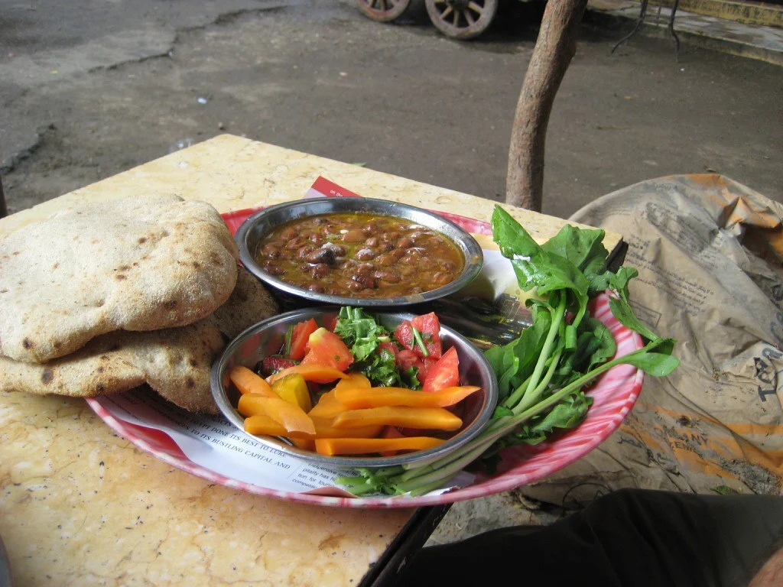
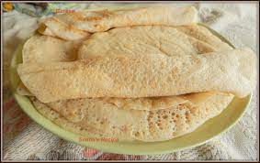
Sudanese food
- Ful Medames (bean dish) - Gurasa (wheat based flat bread)

Slide 3
Sudanese Culture
- Honor
- Politeness
- Humility
- Generosity
- Hospitality

Slide 4
Facts about Sudan
- Population: 45.5 million
- Religion: 97% Sunni Islam, 1.5% Christianity, 1.5% Other
- Median Age: 36

